Slide 1
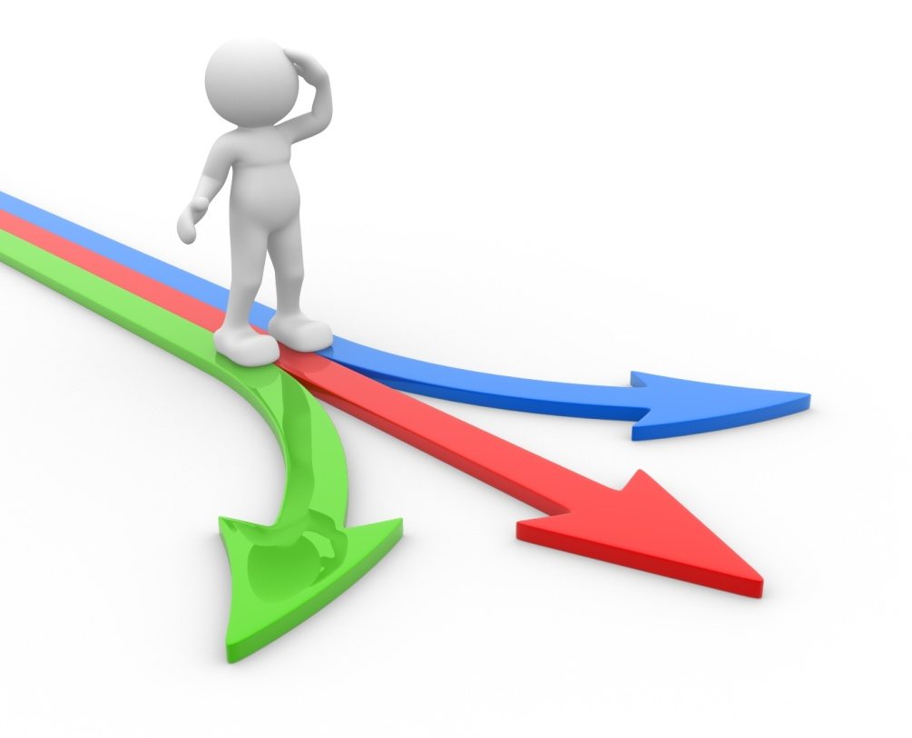
The Dilemma Posed by Scarcity
SCARCITY is a fact of life. While people’s desire for goods and services is unlimited, the resources to produce them ARE limited.

Slide 2

Individuals and Societies Must Devise Ways to Deal with This Problem
How can we effectively allocate scarce items?
Rationing
Lottery
Achievement- based
Need-based
Brute force
First come, first served
Appearance

Slide 3
What Are Some Examples of These Forms of Allocation?
Rationing – wartime, OPEC oil crisis, sales
Lottery – sporting-event tickets, prizes, unpleasant tasks
Achievement-based – contests, college admissions
Need-based – means-tested welfare, medical triage
Brute force – war
First come, first served – “Black Friday,” organ transplant
Appearance – nightclub entry

Slide 4


Markets Typically Allocate Resources Based on Price and the Ability to Pay

Slide 5
Should There Be a Market for Kidneys?
4,720 people died in 2012 while waiting for kidney transplants in the United States.
In each of the past five years, more than 2,600 kidneys were recovered from deceased donors and discarded without being transplanted.
For 25 years, the waiting list for deceased-donor kidneys, currently 93,413, has remained stubbornly rooted in a federal policy that amounts largely to first come, first served.
Source: http://www.nytimes.com/2012/09/20/health/transplant-experts-blame-allocation-system-for-discarding-kidneys.html?pagewanted=all&_r=0

Slide 6
Should There Be a Market for Kidneys?
Watch the following video clip of a “Law and Order” episode: http://www.criticalcommons.org/Members/economicstube/clips/svukidneybrighter.wmv
After watching the video clip, answer the following questions:
Would the transplant process be more efficient if people could buy and sell organs? Explain.
Is it ethical to trade in organs, and what would be the negative consequences of this market?

Slide 7
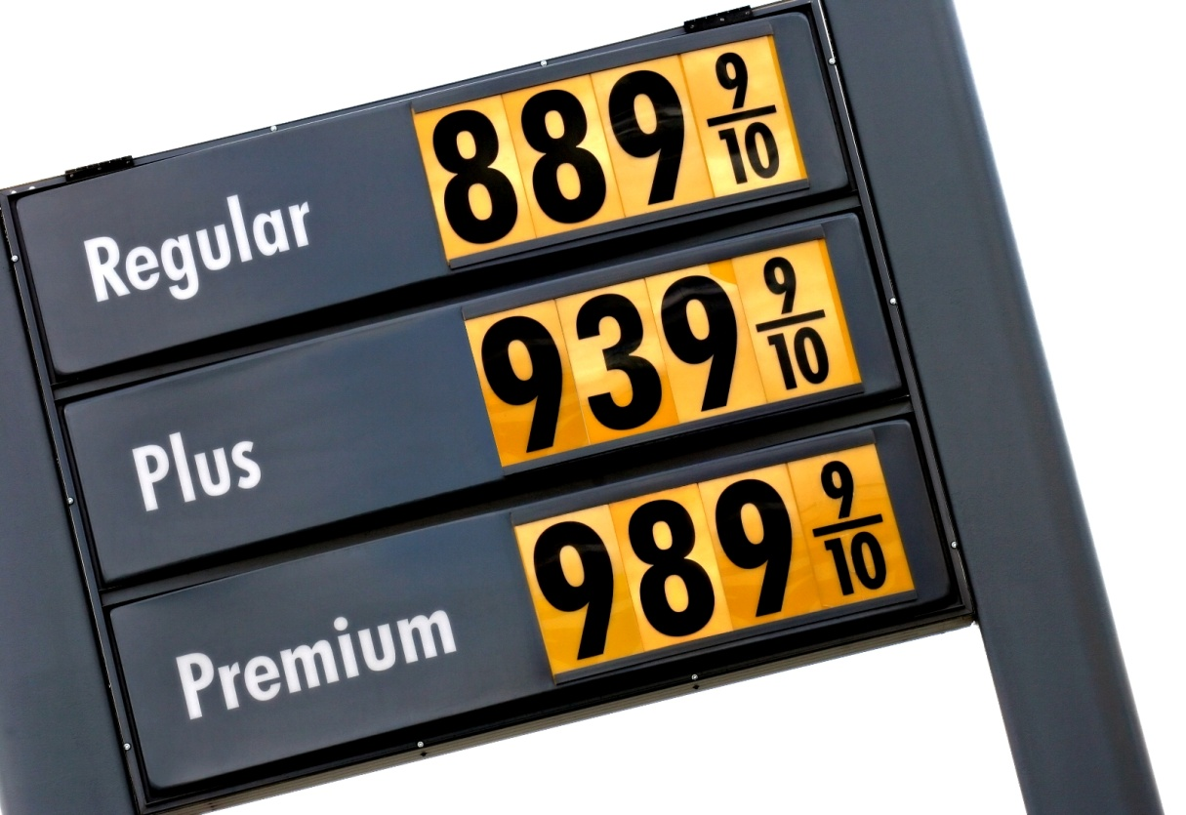
What Is Price Gouging?
Price gouging occurs when merchants artificially raise the price of consumer goods that are in an emergency or natural disaster. The definition of price gouging is not settled in some jurisdictions.

Slide 8
Legal Definitions Vary
Virginia & Tennessee
Arkansas & Alabama
Arkansas follows a more strict approach, prohibiting price increases above 10% for storm recovery products. Meanwhile, Alabama allows for higher price hikes; it only prohibits raising prices above 25% of the average price for the previous 30 days.
Price gouging is an “unconscionable” or “unreasonable” price hike. The exact definition of those terms is then left to the discretion of the Attorney General in the first instance, and then to a judge or jury if a case is tried.

Slide 9
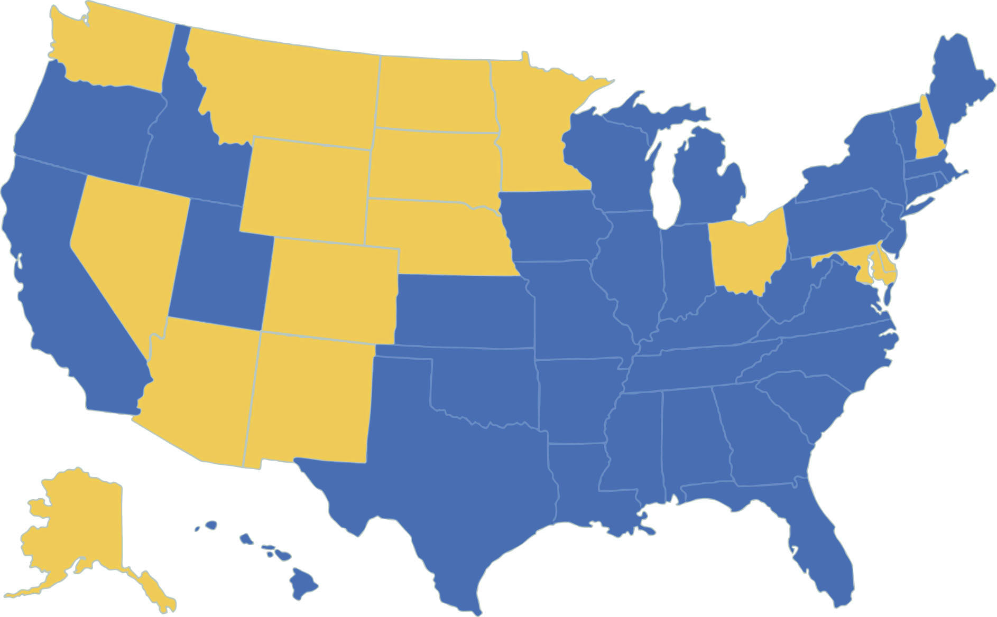
Blue States Have Laws in Place
States with Anti-Price Gouging Laws
FPO

